Slide 1
1. Teacher Instructions
Pre-visit: Introduction Lesson
Length: Approximately 2 x 60 minutes
Description: Students participating in the Future Water Story at the Western Treatment Plant, will explore the theme:
How do human-induced environmental changes impact water in Melbourne and what management strategies are required – for sustainability and human wellbeing.
This lesson is aimed at preparing your students for their visit to the WTP. It includes key content and terms to help them participate in the Future Water Story.
Overview:
Students learn about sustainability, environmental change and how management supports human wellbeing
Students complete tasks and write notes to prepare for the Future Water Story
Allocate your students into teams to participate in the Circular Cities Digital Challenge
Optional extra lesson: Western Treatment Plant – GIS map task (Length 60 minutes)
***See Notes on each slide for more teaching notes and ideas***

Slide 2
Instructions
The following is a suggested sequence of activities and time allocation. You might want to spend more or less time on specific sections depending on your class and their learning requirements. All resources can be edited to suit your teaching needs.
Slide | Description | Time
1.1: Introduction | Key themes students will investigate | 5 minutes
Section: Key knowledge
1.2: Sustainability | What is sustainability? Use the definitions from the Victorian Curriculum | 15 minutes
1.3: Urban water usage | Greater Melbourne water usage breakdown (2019/20) | 10 minutes
1.4: Daily water use | Table showing average daily total water use for Melbourne including non-residential | 10 minutes
1.5: Environmental Change | How is Climate Change affecting water | 15 minutes
1.6: Streamflow | Streamflow into Melbourne’s four major harvesting storages | 10 minutes
1.7: Securing our water supply | Video outlining current water management plans | 10 minutes
1.8: Desalination | Graph showing storage levels with and without annual desalinated water contributions | 10 minutes
1.9: Environmental worldviews | Introduce the three main environmental worldviews | 10 minutes
Section: Preparing for your visit
1.10 – 1.11: Future Water Story | Introducing the Future Water Story and allocating your students into groups | 15 minutes
1.12: KFL Chart | ‘Know’, ‘Find out’ and ‘Learnt’ | 10 minutes

Slide 3
The Future Water Story
Pre-visit lesson

Slide 4
Learning outcomes
​Describe the connection between weather and climate and water​​
Outline the causes and consequences of water scarcity and how it impacts sustainability
Explain the different approaches and knowledge used to address the management of water scarcity, to ensure water security and a more sustainable future
Describe how human-induced climate change will impact resource supply and consumption (water)
Outline how people’s environmental worldviews can lead to different interpretations of human wellbeing and how this impacts decisions around sustainability and water use
Notes:
Teaching notes & ideas:
You could add how population growth and climate change will impact water security in Melbourne.
The focus of the Future Water Story is on Melbourne, you could add reference to other cities around the world your class is investigating.
Environmental change and management examines the functions of the environment that support people’s lives and wellbeing, as well as ways of assessing the sustainability of these functions. Students identify environmental changes that threaten sustainability and therefore need management. Students examine the impacts of people’s attitudes, values and ways of thinking on their views of environment management. Students have the opportunity to examine the causes and consequences of a change within the context of a specific environmental issue and the strategies to manage the change, including the application of geographical concepts and methods.
. Finally, students investigate programs to raise human wellbeing in Australia and overseas

Slide 5
1.1: Introduction
How do human-induced environmental changes impact water in Melbourne and what management strategies are required – for sustainability and human wellbeing.
Notes:
Teaching notes & ideas
Explain to students that they'll be visiting the Western Treatment Plant to participate in the Future Water Story and that they will be exploring the theme: How do human-induced environmental changes impact water in Melbourne and what management strategies are required – for sustainability and human wellbeing.
You could begin with a quick discussion about what students know about the Western Treatment Plant and why it is important:
Do you know where the Western Treatment Plant is located?
Have you ever visited the Western Treatment Plant?
Do you know any facts about the plant?
What would happen if you flushed the toilet, and it didn't work?
Key terms students should know to get the most out of the experience – see Glossary. The terms students will need to know include
Grey water
Ponds
Run-off
Activated sludge
Reservoir
Sewage
Sewerage
Stormwater
Wastewater
Water cycle
Desalination
Biosolids
Biogas
Drought
Dam
Water scarcity

Slide 6
Key knowledge
Notes:
Teaching notes & ideas
The next slides outline the key terms and concepts that will be discussed and covered as part of the Future Water Story.

Slide 7
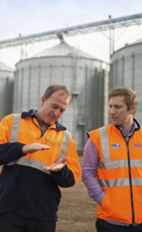
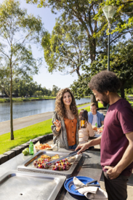
1.2: Sustainability
What is sustainability
Sustainability means the ability to meet the needs of the present without compromising the ability of future generations to do the same.
Sustainability incorporates three pillars
Environmental
Economic
Social/ Emotion
Notes:
Teaching notes & ideas
Students will need to understand the concept of sustainability and its three pillars. You can use the definitions from the Victorian Curriculum Geographical Concepts and the Cross-Curriculum Priority.
Get students to write down this definition and to make notes for each pillar: Environmental, Economic and Social.

Slide 8
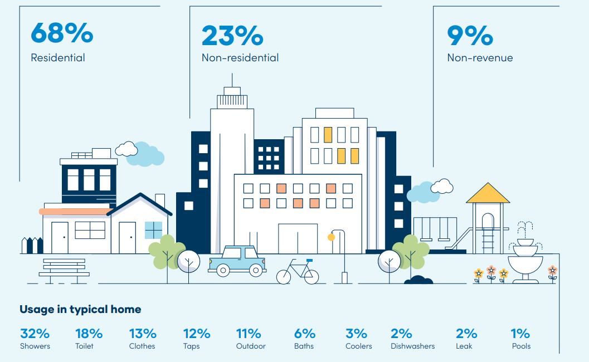
1.3 Urban water usage
Greater Melbourne water usage breakdown (2019/20)
Source: Greater Melbourne Urban Water and System Strategy
Notes:
Teacher notes & ideas
Discuss with students how water is used in Greater Melbourne
Remind students that this is water use in an urban setting. The data for the state and Australia is different.
Check the Australian Bureau of Statistics for the most recent data. But generally, agriculture is the largest user of water, followed by households, manufacturing, mining and other industries.

Slide 9
1.4: Daily water use
Average daily total water use for Melbourne including non-residential
Source: Annual Report | Melbourne Water
Notes:
Teaching notes & ideas
Supplying our customers
To meet customer demand, Melbourne Water supplied 471 billion litres of water in 2023-24, which is 4 per cent more than the previous year.
Water consumption
Despite high rainfall, permanent water saving rules still apply across Victoria to ensure we use water wisely. Melbourne's residential water use in 2023-24 was 162 litres per person per day4, which is 12 litres more than the Victorian Government’s new target of 150 litres.
Melburnians averaged use of 1.27 billion litres of water per day this year – 5 per cent more than the last five-year average, which was influenced by wet conditions from three consecutive wet La Nina years and the coronavirus (COVID-19) pandemic. While water consumption has generally increased over the past 10 years, it is 4 per cent lower than during the 1990s.

Slide 10
1.5: Environmental change
Water supply challenges
The effects of climate change
hotter and drier weather
possibility of more severe bushfires
unpredictable storms and floods
less rainfall over time
possibility of another drought
All these effects impact on our water supply.
Notes:
Teaching notes & ideas
Discuss how climate change, a human-induced environmental change will impact water supply in Melbourne.
Also note to students that the population on Melbourne is also growing. So, although people may be using less water per person, more water is being used due to population increases.

Slide 11
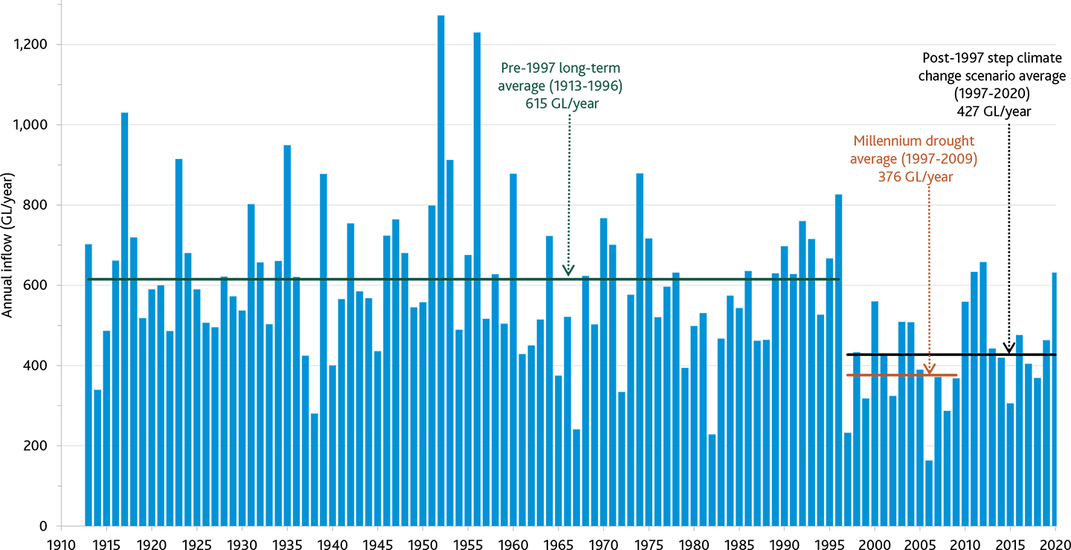
1.6: Streamflow
Streamflow into Melbourne’s four major harvesting storages
Source: Challenges to Melbourne's water supply | Melbourne Water
Notes:
Teaching notes & ideas
This graph outlines the long-term decrease of stream inflow into Melbourne’s four major harvesting reservoirs. This decline is expected to continue, due to the effects of climate change.
Discuss what the implications of climate change on Melbourne’s water supply and how these will impact sustainability and human-wellbeing.
Students can write down their thoughts using the three principles of sustainability: environmental, economic and social

Slide 12
1.7: Securing our water supply
Notes:
Teacher notes & ideas
Watch the video and ask students to write down the
Impacts of the Millennium drought
What was learnt during that time from a planning perspective
Alternative water resources: use of recycled water, harvesting stormwater and a desalination plant
Water saving habits
Discuss how these management strategies are beneficial for sustainability and human wellbeing.

Slide 13
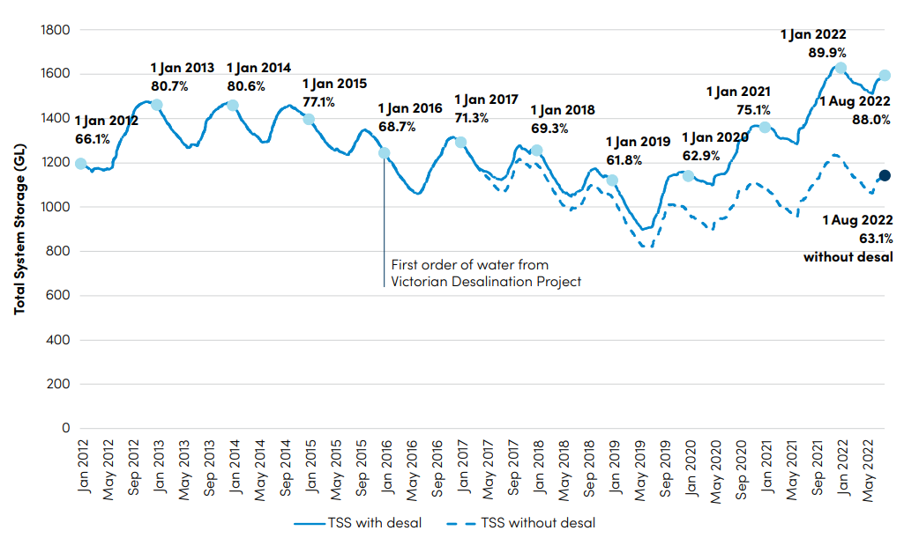
1.8: Desalination
Comparison of Melbourne’s total system storage levels over the last five years with and without annual desalinated water contributions
Source: Greater Melbourne Urban Water and System Strategy
Notes:
Teacher notes & ideas

Slide 14
1.9: World views and sustainability
Human-centred
Humans separate from nature
Environmental problems solved by technology
Eco-centred/ Stewardship
Humans need to be ethically responsible stewards of nature
Need to manage nature, for human and natures benefit
Earth-centred
Humans are part of and dependent on nature
Work with nature to solve problems
No limit to economic growth
Natural resources are plentiful but need to be managed
Earth’s resources are limited and should not be wasted
Notes:
Teaching notes & ideas
Have a discussion and get students to consider the influence of people’s environmental worldviews on their support for environmental sustainability – and how to manage Melbourne’s water supply.

Slide 15
Preparing for your visit
Notes:
Teaching notes & ideas
The next two slides are aimed at getting your students ready and excited to participate in the Future Water Story.

Slide 16
1.10: Future Water Story – introducing the challenge & teams!
Notes:
Teaching notes & ideas
Watch the video

Slide 17
1.11: Future Water Story – the teams!
Notes:
Teaching notes & ideas
Your students need to be allocated into teams. You may choose to allocate students or get them to nominate the group they would like to be part of.
The groups: Banksia Sports, Culture Ark, Collins Family Farm, Creekside Science, Wattle School P&F and Health & Hue
When students are participating in the challenge, they will need to consider the ‘needs’ and ‘requirements’ of their group. You can also discuss the possible environmental worldview of each group.

Slide 18
1.12: ‘Know’, ‘Find out’ and ‘Learnt’
How do we make the use of water in Australia sustainable?
WHAT DO I ALREADY KNOW? | WHAT TO I WANT TO FIND OUT? | WHAT HAVE I LEARNT?
Notes:
Teaching notes & ideas
Get students to draw the following table and complete the first two columns ‘Know’ and ‘Find out’. They should write at least 4 pieces of information in each column.
Learnt – to be completed after their visit to the Western Treatment Plant
Suggested responses
Know: What is a catchment, the difference between an open and closed or protected catchment, the three pillars of sustainability, where my water comes from, the different types of alternate water, why sanitation is important, the impact of droughts …
Find out: How smelly is the WTP?, What is biogas?, How is recycled water made?, What type of birds/ animals will I see?, Why are we going to a sewage treatment plant?

Slide 19
Are you ready for the Future Water Story?

Slide 20
Curriculum links
Geography: VC2HG10K10, VC2HG10K11, VC2HG10K13, VC2HG10K14, VC2HG10K15, VC2HG10K16
Science: VC2S10H02, VC2S10H03, VC2S10H04, VC2S10U11

